Slide 1
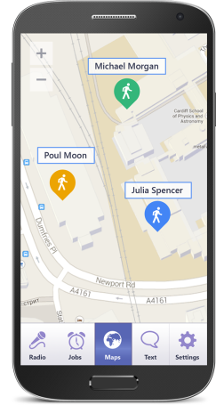
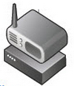
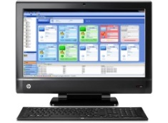
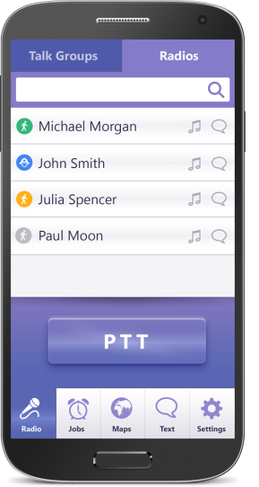
1. Swift Agent for TRBOnet Mobile Client
Voice and Data. All type of calls
TRBOnet Mobile Client
Wi-Fi, 3G, LTE
Site 1
UDP/IP
Site 2
TRBOnet Enterprise
Site 3
TRBOnet Mobile Client

Slide 2
1. Control Stations for TRBOnet Mobile Client
Voice and Data: All type of calls
TRBOnet Mobile Client
Wi-Fi, 3G, LTE
TRBOnet Enterprise
TRBOnet Mobile Client

Slide 3
3. IP Connect to Repeater
Data – all calls
Voice – no to radios (calls to Dispatcher – okay, calls between Androids – okay)
TRBOnet Mobile Client
Wi-Fi, 3G, LTE
LAN
TRBOnet Enterprise
TRBOnet Mobile Client

